Slide 1


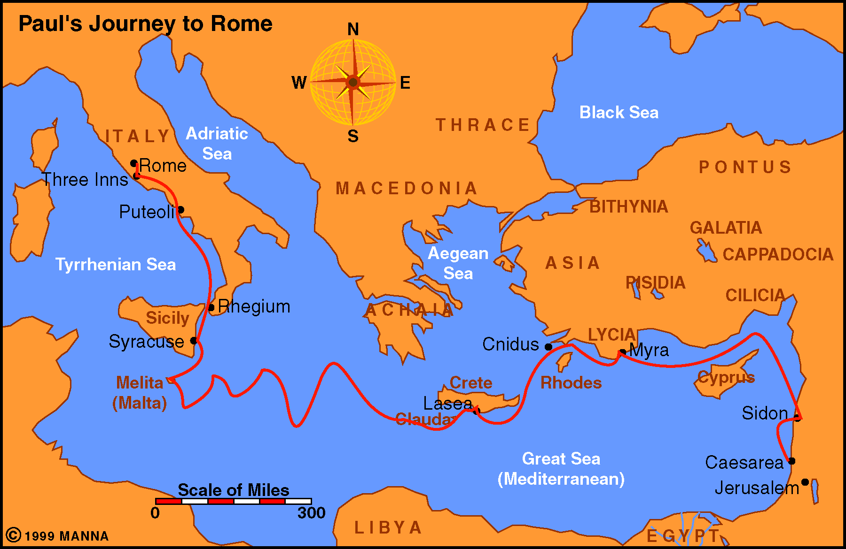
Geography of the Roman Empire, Paul's Journeys & Letters
165
Dr. Rick Griffith • Jordan Evangelical Theological Seminary • BibleStudyDownloads.org

Slide 2

Roman Territories (50 BC-AD 100)
165

Slide 3



Emperors
185
vs.
Herodians
Empi
re
Home

Slide 4
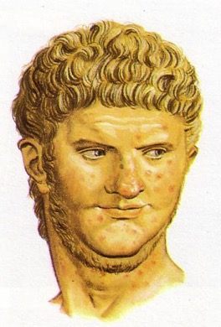
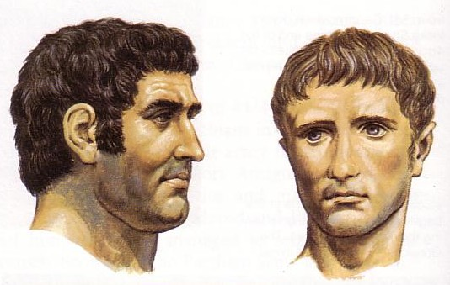
Roman Emperors
175

Slide 5
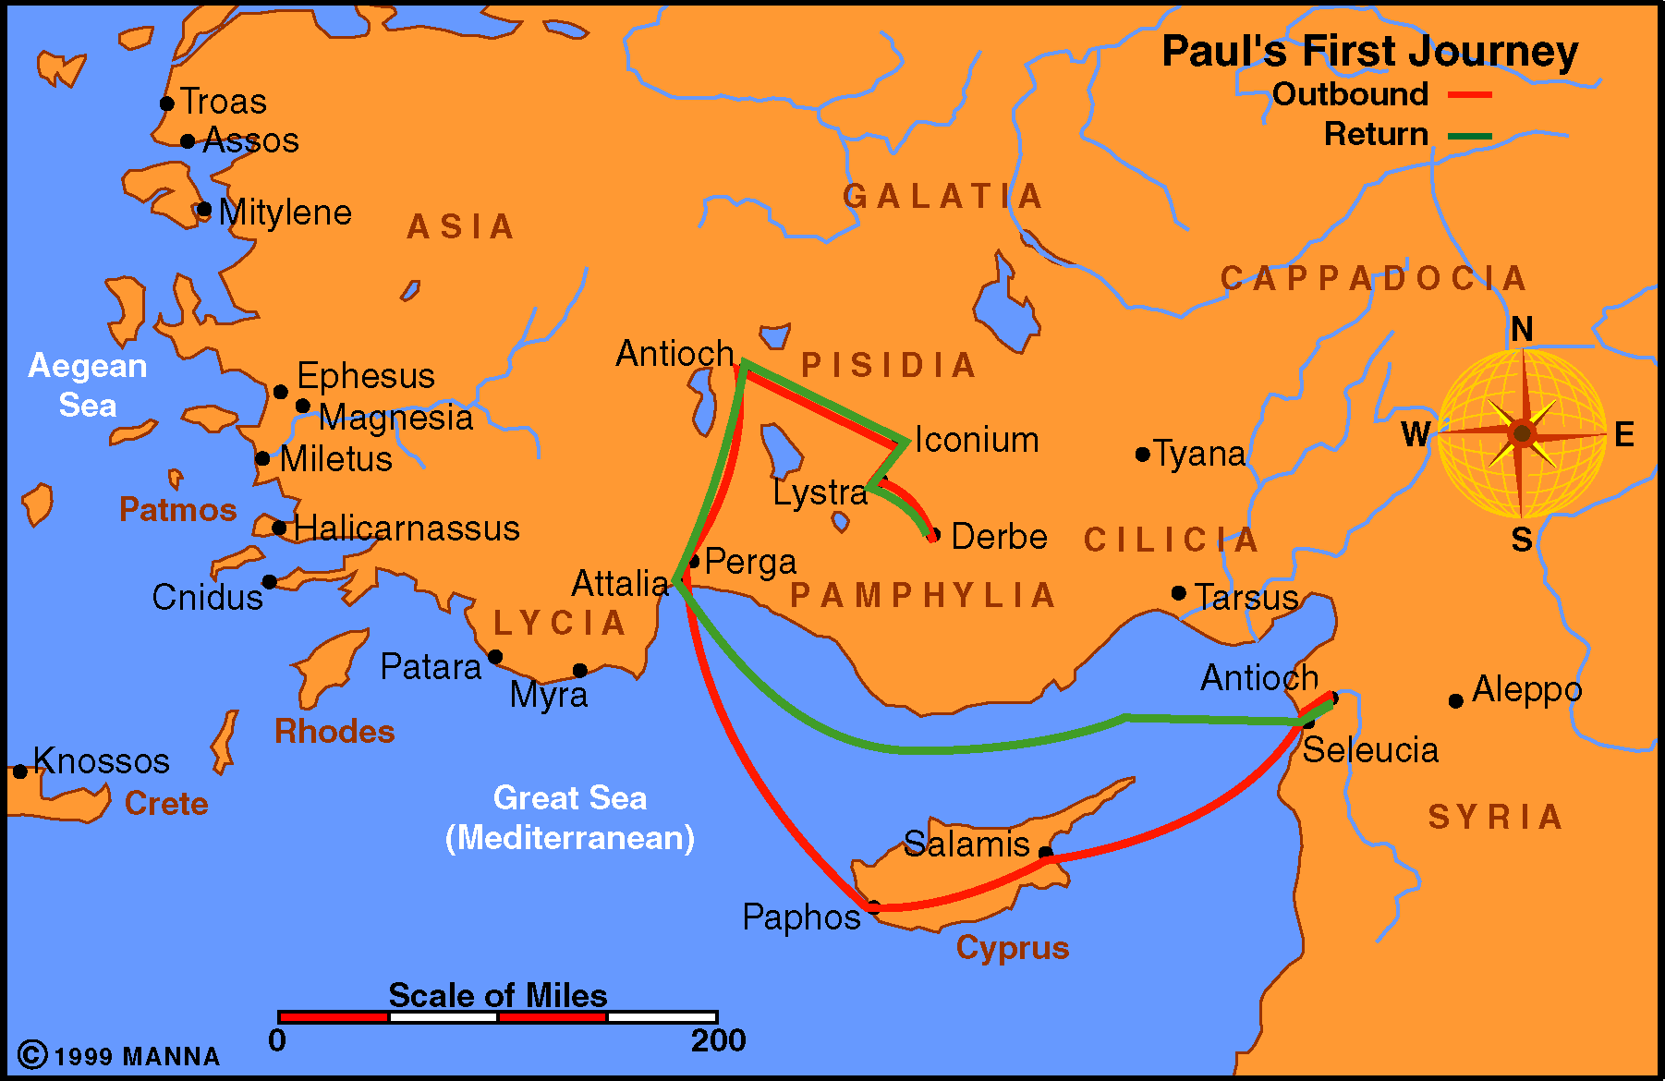
Paul Journey 1
166

Slide 6
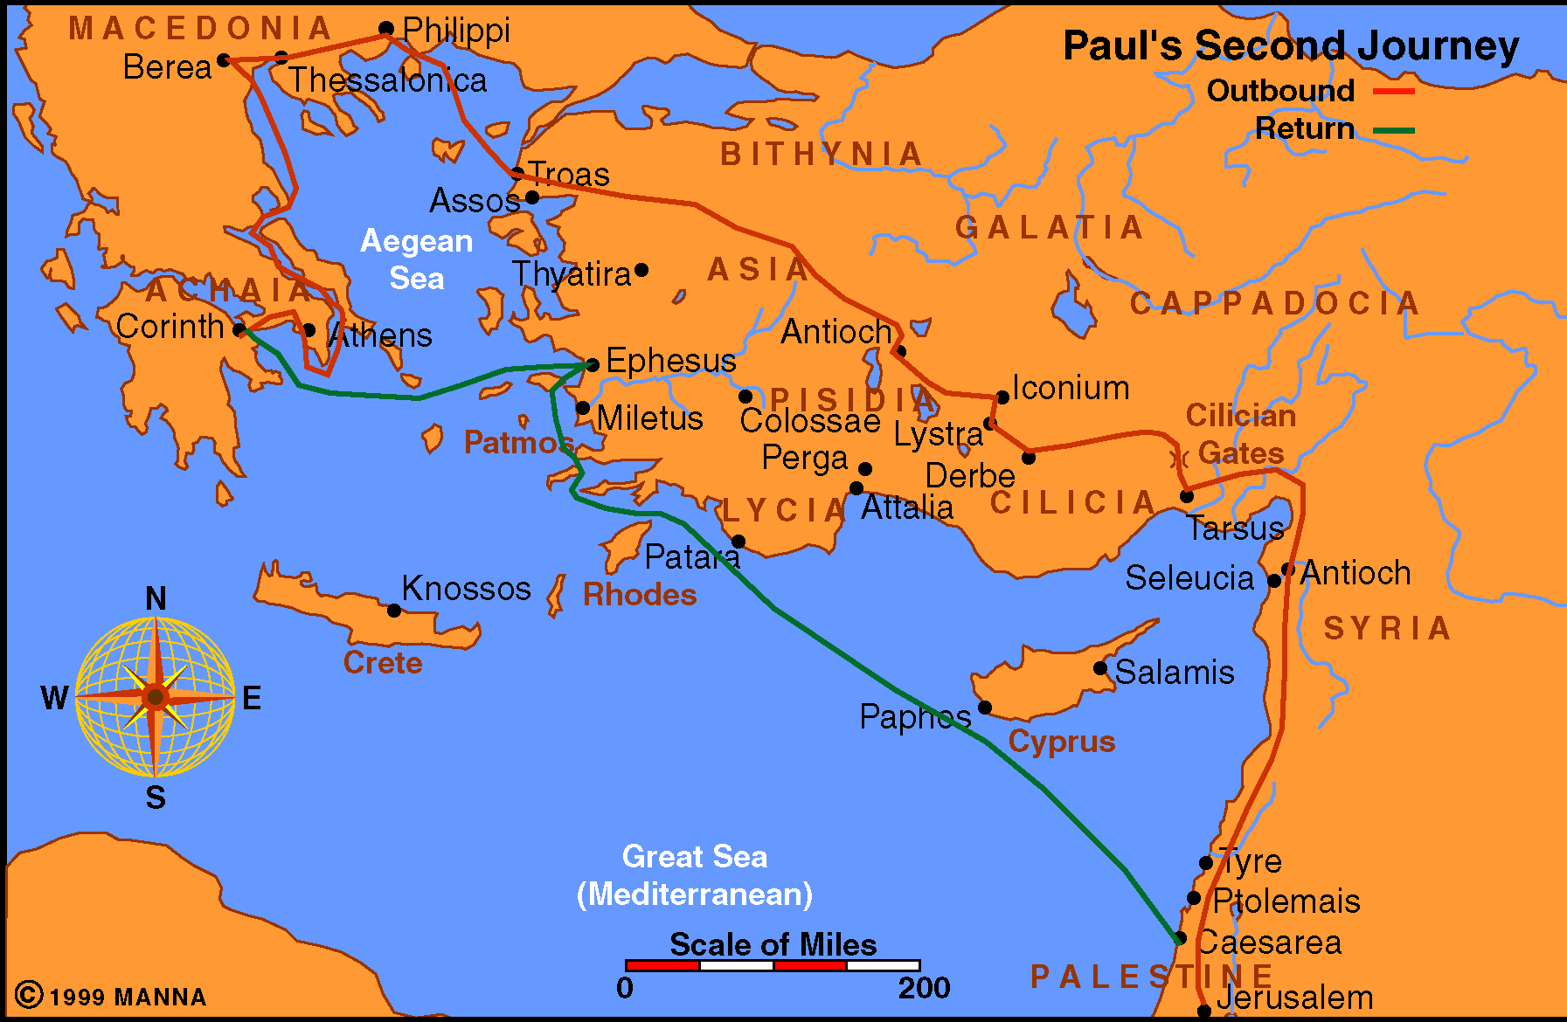
Paul Journey 2
166

Slide 7
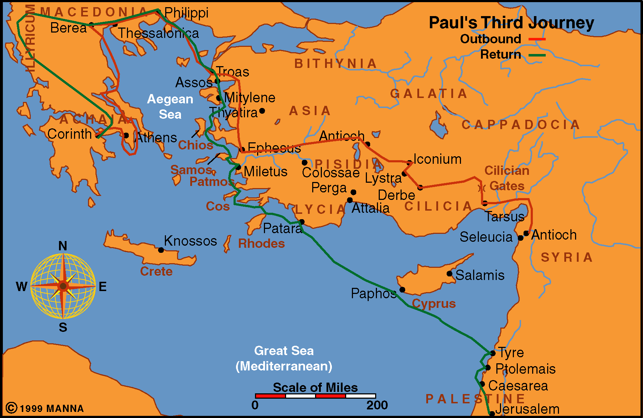
Paul Journey 3
167

Slide 8
Paul Journey to Rome
167

Slide 9
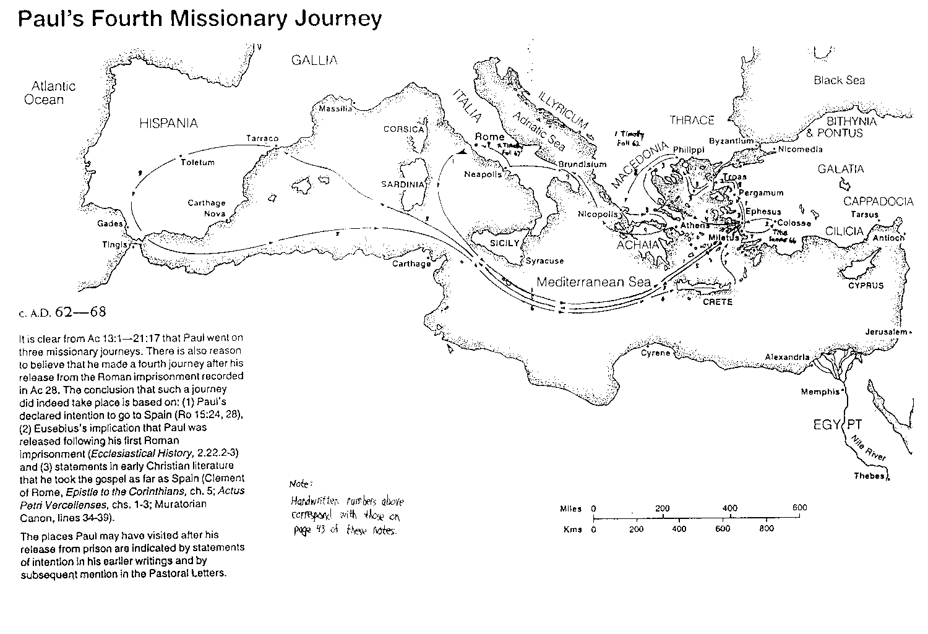
Paul’s Fourth Missionary Journey
168

Slide 10
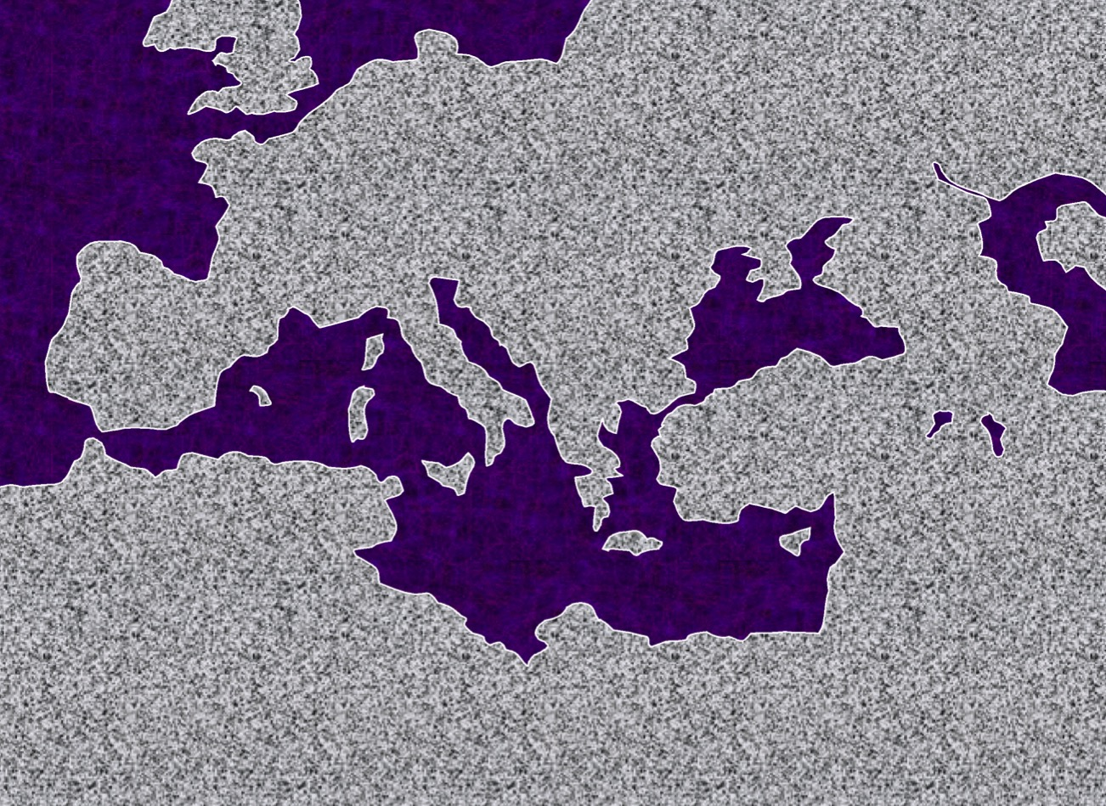

Roman Empire Extent
ATLANTIC OCEAN
EUROPE
ROMAN EMPIRE
ASIA
ROME•
•
AFRICA
ISRAEL
MEDITERRANEAN SEA
ARABIA
8.0.08.
© 2004 TBBMI
41

Slide 11
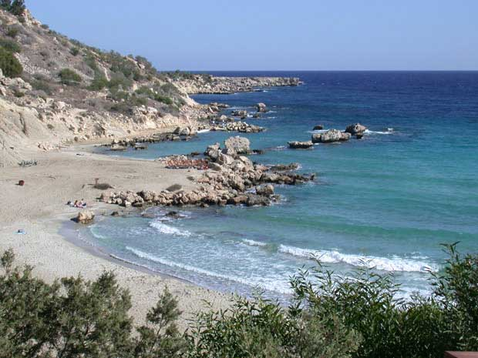
Journey 1
STUDY HELP #24
PAUL’S JOURNEYS …AT A GLANCE
ATLANTIC OCEAN
A.D. 46-48
EUROPE
A BEACH ON CYPRUS
ASIA
ROME•
•Macedonia
•Pisidian Antioch
•
•Ephesus
AFRICA
Athens
Acts 13-14
•Syrian Antioch
MEDITERRANEAN SEA
#1.“The Hook: A Laboratory”
•Jerusalem
Significance: Worshipped as gods; did miracles; Paul stoned; difficult work; churches planted; return by same route.
ARABIA
8.0.08.
14
© 2004 TBBMI
42

Slide 12
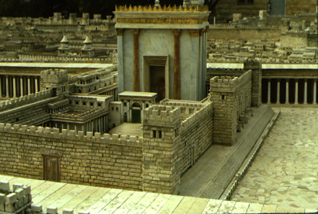
Jerusalem Council
A.D.49
PAUL’S JOURNEYS …AT A GLANCE
Acts 15:1: Must a Gentile become a Jew, and accept his laws and ceremonies, before he can become a Christian?
ATLANTIC OCEAN
EUROPE
GRACE ONLY!
ASIA
ROME•
•Macedonia
•Pisidian Antioch
•
•Ephesus
AFRICA
Athens
Acts 15
•Syrian Antioch
MEDITERRANEAN SEA
1(--)2“The Jerusalem Council”
•Jerusalem
The issue was permanently settled: GRACE, not LAW!
ARABIA
8.0.08.
4
© 2004 TBBMI
43

Slide 13
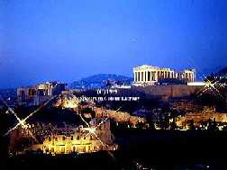
Journey 2
ATLANTIC OCEAN
A.D. 49-52
EUROPE
ASIA
ROME•
•Macedonia
•Pisidian Antioch
•
•Ephesus
AFRICA
Athens
Acts 15-18
•Syrian Antioch
MEDITERRANEAN SEA
2. “The European Thrust”
•Jerusalem
Significance: many church plantings; call to Macedonia,on to Athens, the “unknown god”; Mars Hill; lengthy Corinthian stay.
ARABIA
8.0.08.
5
8.0.08.
©2004 TBBMI
44
© 2004 TBBMI

Slide 14
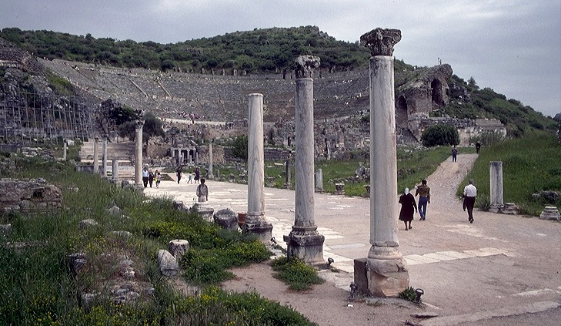
Journey 3
ATLANTIC OCEAN
A.D. 53-57
EUROPE
ANCIENT EPHESUS
ASIA
ROME•
•Macedonia
•Pisidian Antioch
•
•Ephesus
AFRICA
Athens
Acts 18-21
•Syrian Antioch
MEDITERRANEAN SEA
3.“The Asian Thrust”
•Jerusalem
Significance: extended time at the church in Ephesus; young man raised from the dead; important letters written; riot with Ephesian artisans at amphitheatre.
ARABIA
8.0.08.
4
45
© 2004 TBBMI
8.0.08.

Slide 15
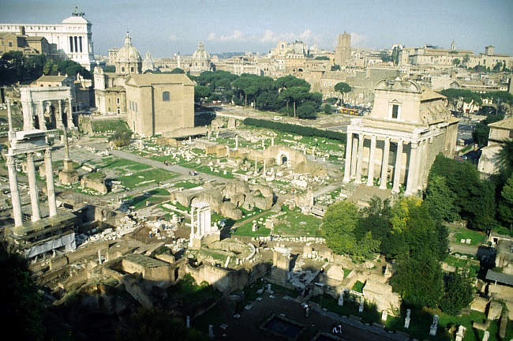
Journey 4
A.D. 59-62
STUDY HELP # 36
ATLANTIC OCEAN
EUROPE
ASIA
ROME•
ROME’S ANCIENT FORUM
•Macedonia
•Pisidian Antioch
•
•Ephesus
AFRICA
Athens
Acts 21-28
•Syrian Antioch
MEDITERRANEAN SEA
4. “To Rome and GAIN!”
•Jerusalem
ARABIA
Significance: As a prisoner, sent to Rome; Christian influence in prison and the house of Caesar; important later letters; “fought the good fight, kept the faith!”
8.0.08.
3
8.0.08.
© 2004 TBBMI
46

Slide 16
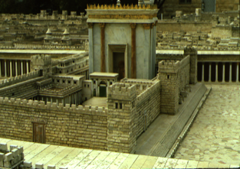

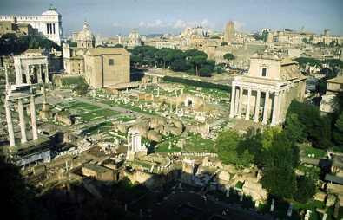
Journey Summary
STUDY HELP #36
#1 THE HOOK: A LABORATORY
AT A GLANCE: PAUL’S MISSIONARY JOURNEYS
ATLANTIC OCEAN
EUROPE
(21 Books)
INTERIM: JERUSALEM COUNCIL
ASIA
CHURCH
ISSUES
•Macedonia
#2: THE EUROPEAN THRUST
•Pisidian Antioch
•
•Ephesus
AFRICA
Athens
The Epistles
•Syrian Antioch
MEDITERRANEAN SEA
•Jerusalem
#3: THE ASIAN THRUST
ARABIA
#4: TO ROME AND GAIN
8.0.08.
7
47

Slide 17
The NT Comes Together
(21 Books)
CHURCH
ISSUES
THE EPISTLES: Letters from Paul
Dates of Writing:
A.D. 50s - 90s
THE EPISTLES
Concerning generally unexplored issues requiring new and crucial instruction in leadership of the new organism...
the ECCLESIA,
the CHURCH.
Most letters from Paul …fewer letters from “The Others.”
Letters from
The Others
Letters from
The Others
48
3

Slide 18
The Spread of the Early Church
(21 Books)
CHURCH
ISSUES
THE EPISTLES: Letters from Paul
Dates of Writing:
A.D. 50s - 90s
THE EPISTLES
Concerning generally unexplored issues requiring new and crucial instruction in leadership of the new organism...
the ECCLESIA,
the CHURCH.
Most letters from Paul …some fewer from “The Others.”
Letters from
The Others
Letters from
The Others
THE SPREAD OF THE EARLY CHURCH
REPRESENTATIONAL LOCATIONS ONLY
8.0.08.
©2004 TBBMI
49

Slide 19
Where were they written?
ROME
EPHESIANS
MACEDONIA
COLOSSIANS
PHILEMON
2 CORINTHIANS
PHILIPPIANS
1 TIMOTHY..
EPHESUS
HEBREWS?
1 PETER
CORINTH
2 PETER
1 CORINTHIANS
SYRIAN ANTIOCH
ROMANS
2 TIMOTHY..
1 THESS
TITUS
2 THESS..
1 JOHN
2 JOHN
GALATIANS..
Where were they written?
3 JOHN..
JERUSALEM
JAMES
JUDE..
8.0.08.
27
©2004 TBBMI
67

Slide 20
The circular letters… keeping in touch
ROME
EPHESIANS
MACEDONIA
COLOSSIANS
PHILEMON
2 CORINTHIANS
PHILIPPIANS
1 TIMOTHY..
EPHESUS
HEBREWS?
1 PETER
CORINTH
2 PETER
1 CORINTHIANS
SYRIAN ANTIOCH
ROMANS
2 TIMOTHY..
1 THESS
TITUS
The circular letters… keeping in touch
2 THESS..
1 JOHN
2 JOHN
GALATIANS..
3 JOHN..
JERUSALEM
JAMES
JUDE..
8.0.08.
©2004 TBBMI
68

Slide 21
Black

Slide 22


Bible Geography link at BibleStudyDownloads.org
Get this presentation for free!
Notes:
Bible Geography (bg)

